Slide 1
Unit 13: For Live Session Assignment

Slide 2
Part 1: Quick Quiz Questions

Slide 3
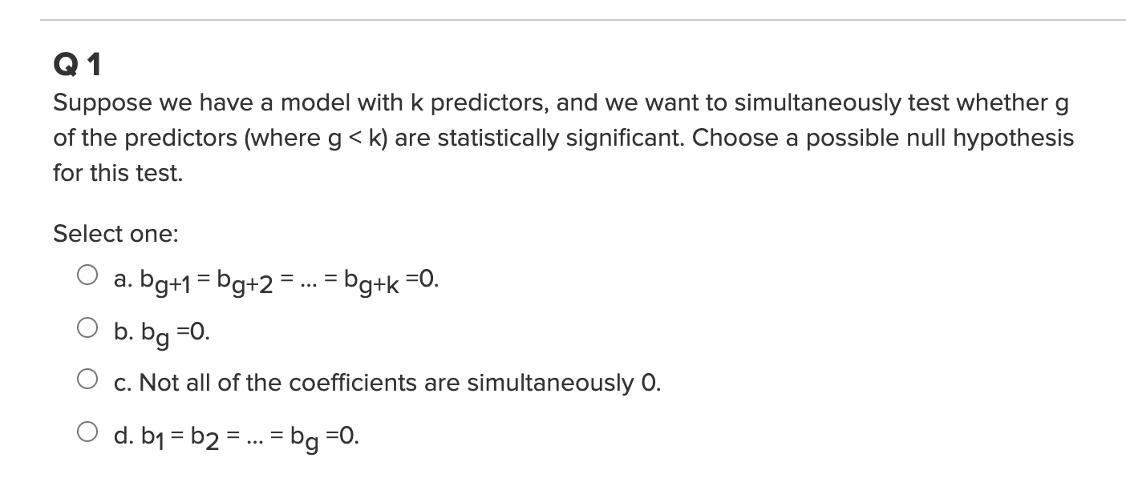
Part 1: Quick Quiz Questions

Slide 4
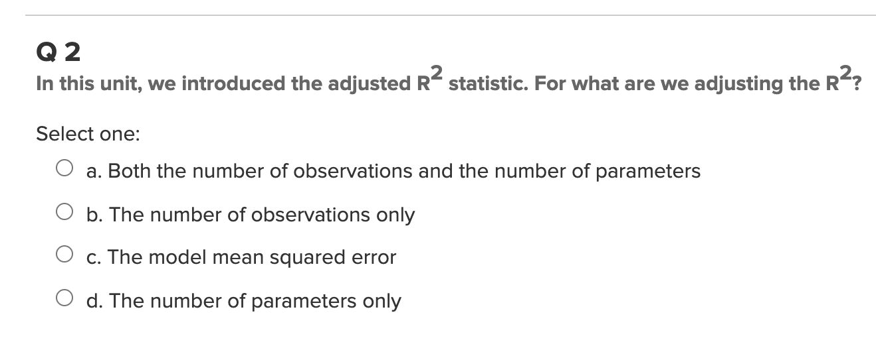
Part 1: Quick Quiz Questions

Slide 5
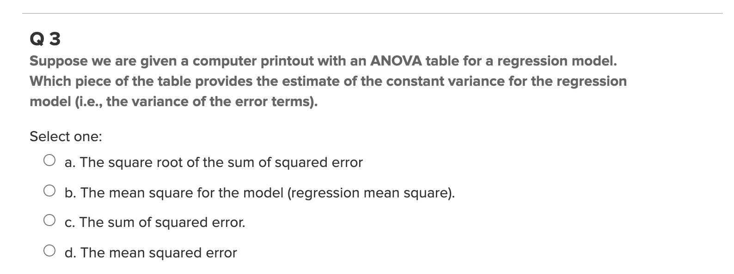
Part 1: Quick Quiz Questions

Slide 6
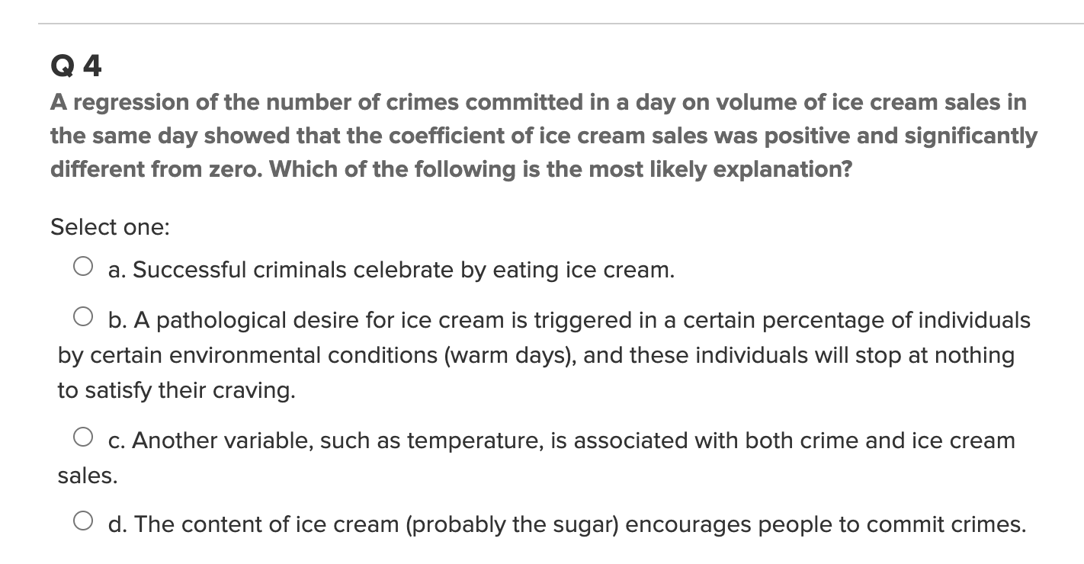
Part 1: Quick Quiz Questions

Slide 7
Part 2: Review the Bat Echolocation Example

Slide 8
Echolocation!!!
QOI: Is there a difference in the in-flight energy expenditures among all three animals after body size is accounted for? Explore the possibility of unequal slopes.
In order to answer this question, it will help first to test if all the regression lines are parallel (if the slopes are equal). If they are, then we can check for a difference in energy expenditure across all body sizes simultaneously. See Display 10.5 on page 276.
$$μ\left\{lenergy \right|lmass, TYPE\}= β_{0}{+β}_{1}lmass{+β}_{2}bird{+β}_{3}ebat{+β}_{4}lmass∗bird{+β}_{5} lmass ∗ebat$$
Indicator variables for the variable TYPE.
Which of the three types of animals (bird, ebat, or nebat) is the reference type in this model?
Nebat
It occurs when ebat = 0 and bird = 0.

Slide 9
Echolocation!!!
$$μ\left\{lenergy \right|lmass, TYPE\}= β_{0}{+β}_{1}lmass{+β}_{2}bird{+β}_{3}ebat{+β}_{4}lmass∗bird{+β}_{5} lmass ∗ebat$$
Individual regression equations for each value of TYPE:
Type = ebat occurs when ebat=1 and bird = 0.
0
0
$$μ\left\{lenergy \right|lmass, TYPE=ebat\}= β_{0}{+β}_{1}lmass{+β}_{2}∗0{+β}_{3}∗1{+β}_{4}lmass∗0{+β}_{5} lmass ∗1$$
$$μ\left\{lenergy \right|lmass, TYPE=ebat\}= β_{0}{+β}_{1}lmass{+β}_{3}{+β}_{5} lmass$$
$$μ\left\{lenergy \right|lmass, TYPE=ebat\}= β_{0}{+β}_{3}{+β}_{1}lmass{+β}_{5} lmass$$
$μ\left\{lenergy \right|lmass, TYPE=ebat\}=\left(β_{0}{+β}_{3}\right)+(β_{1}{+β}_{5})lmass$: slope = $β_{1}{+β}_{5}$
Type = bird occurs when ebat=0 and bird = 1.
0
0
$$μ\left\{lenergy \right|lmass, TYPE=bird\}= β_{0}{+β}_{1}lmass{+β}_{2}∗1{+β}_{3}∗0{+β}_{4}lmass∗1{+β}_{5} lmass ∗0$$
$$μ\left\{lenergy \right|lmass, TYPE=bird\}= β_{0}{+β}_{1}lmass{+β}_{2}{+β}_{4} lmass$$
$$μ\left\{lenergy \right|lmass, TYPE=bird\}= β_{0}{+β}_{2}{+β}_{1}lmass{+β}_{4} lmass$$
$μ\left\{lenergy \right|lmass, TYPE=bird\}=\left(β_{0}{+β}_{2}\right)+(β_{1}{+β}_{4})lmass$: slope = $β_{1}{+β}_{4}$
What is the regression equation for nebat (and slope)?
Type = nebat occurs when ebat=0 and bird = 0.
0
0
0
0
$$μ\left\{lenergy \right|lmass, TYPE=nebat\}=β_{0}{+β}_{1}lmass{+β}_{2}∗0{+β}_{3}∗0{+β}_{4}lmass∗0{+β}_{5} lmass ∗0$$
$μ\left\{lenergy \right|lmass, TYPE=nebat\}=β_{0}+β_{1}lmass$: slope = $β_{1}$

Slide 10
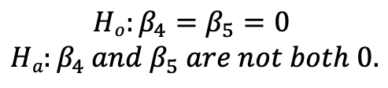
Echolocation!!!
$$μ\left\{lenergy \right|lmass, TYPE\}= β_{0}{+β}_{1}lmass{+β}_{2}bird{+β}_{3}ebat{+β}_{4}lmass∗bird{+β}_{5} lmass ∗ebat$$
Individual regression equations for each value of TYPE:
$μ\left\{lenergy \right|lmass, TYPE=ebat\}=\left(β_{0}{+β}_{3}\right)+(β_{1}{+β}_{5})lmass$: slope = $β_{1}{+β}_{5}$
$μ\left\{lenergy \right|lmass, TYPE=bird\}=\left(β_{0}{+β}_{2}\right)+(β_{1}{+β}_{4})lmass$: slope = $β_{1}{+β}_{4}$
$μ\left\{lenergy \right|lmass, TYPE=nebat\}=β_{0}+β_{1}lmass$: slope = $β_{1}$
All slopes are equal if $β_{1}{+β}_{5}=β_{1}=β_{1}{+β}_{4}, or β_{4}=β_{5}=0$.
$$Ho:β_{4}=β_{5}=0$$
$$Ha:β_{4} and β_{5} are not both 0.$$
We will do this with an Extra Sum of Squares Test
(build your own ANOVA table).

Slide 11
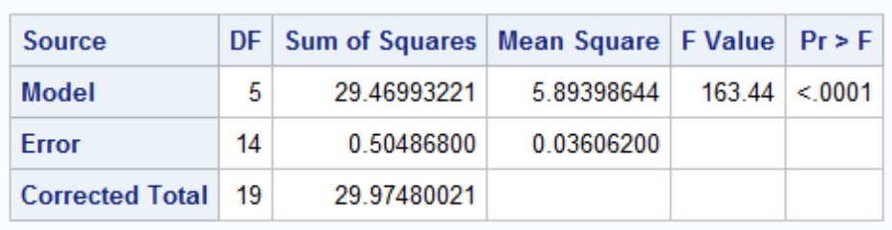
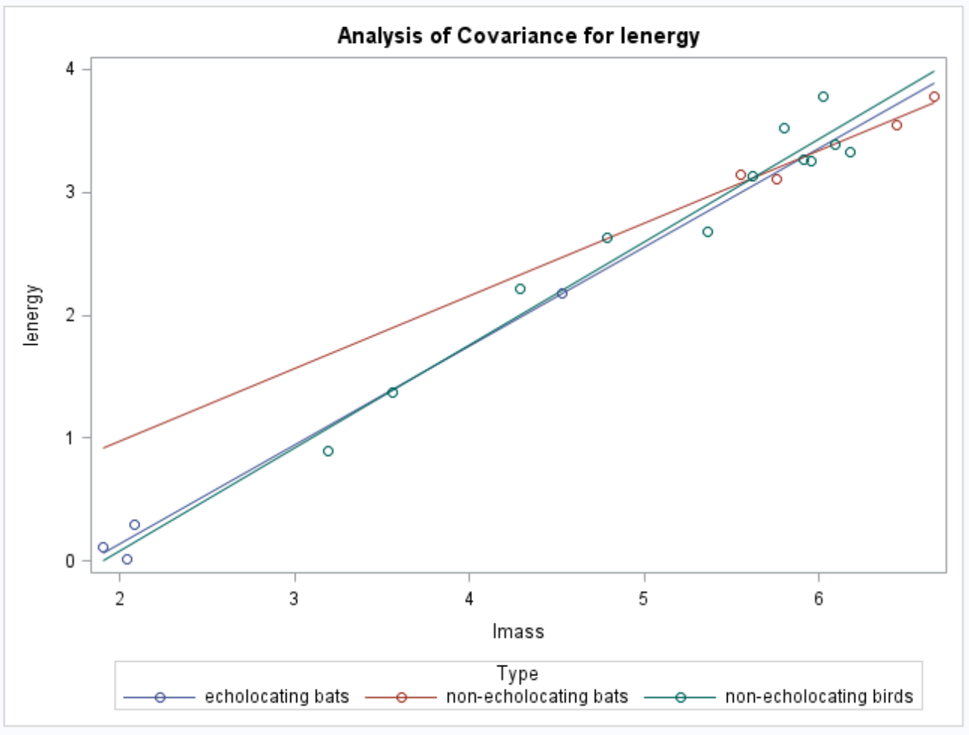
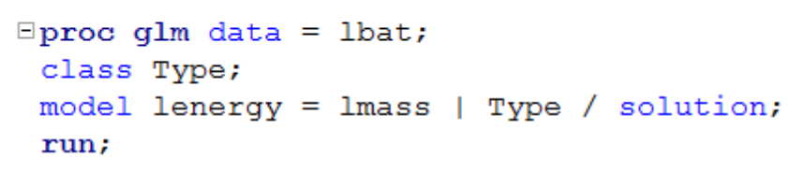
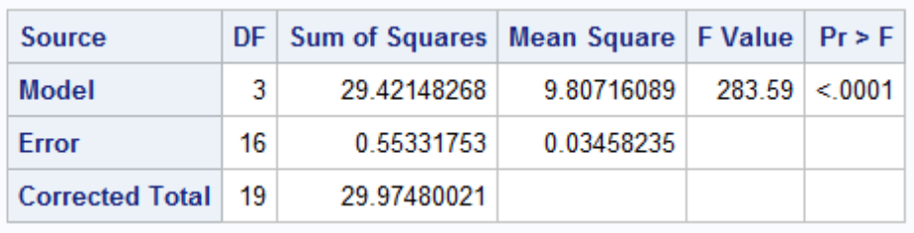
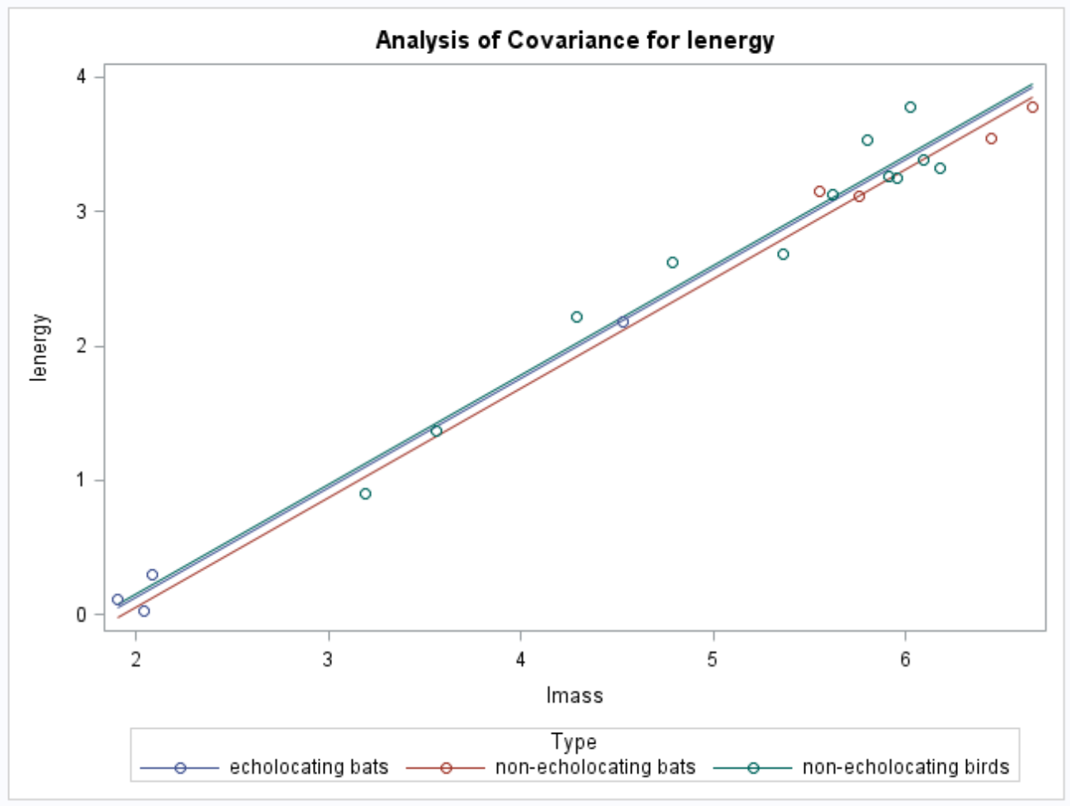
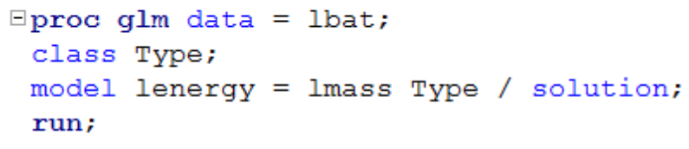
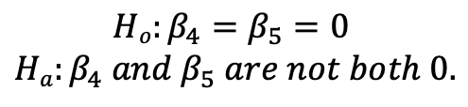
Echolocation!!!
QOI: Is there a difference in the in-flight energy expenditures among animals after body size is accounted for? (Is the model with the interaction between type and body size significantly different from the model without interaction?)
Plan of action: Lack of fit test (also called sum of squares test).
$$Ho:β_{4}=β_{5}=0$$
$$Ha:β_{4} and β_{5} are not both 0.$$
$$μ\left\{lenergy \right|lmass, TYPE\}= β_{0}{+β}_{1}lmass{+β}_{2}bird{+β}_{3}ebat+β_{4} lmass∗bird{+β}_{5} lmass ∗ebat$$
Full Model
$$μ\left\{lenergy \right|lmass, TYPE\}= β_{0}{+β}_{1}lmass{+β}_{2}bird{+β}_{3}ebat$$
Reduced Model

Slide 12
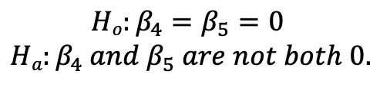
Echolocation!!!
QOI: Is there a difference in the in-flight energy expenditures among animals after body size is accounted for?
$$Ho:β_{4}=β_{5}=0$$
$$Ha:β_{4} and β_{5} are not both 0.$$
$$μ\left\{lenergy \right|lmass, TYPE\}= β_{0}{+β}_{1}lmass{+β}_{2}bird{+β}_{3}ebat+β_{4}lmass∗bird{+β}_{5} lmass ∗ebat$$
Full Model
Reduced Model
Source | Df | SS | MS | F | P-value
Model | 2 | .0485 | .02425 | .67867 | .5232
Error | 14 | .5048 | .0361
Total | 16 | .5533
Source | Df | SS | MS | F | P-value
Model
Error
Total
Full Model
Reduced Model

Slide 13
Echolocation!!!
QOI: Is there a difference in the in-flight energy expenditures among animals after body size is accounted for?
$$Ho:β_{4}=β_{5}=0$$
$$Ha:β_{4} and β_{5} are not both 0.$$
$$μ\left\{lenergy \right|lmass, TYPE\}= β_{0}{+β}_{1}lmass{+β}_{2}bird{+β}_{3}ebat+β_{4}lmass∗bird{+β}_{5} lmass ∗ebat$$
Full Model
Reduced Model
Source | Df | SS | MS | F | P-value
Model | 2 | .0485 | .02425 | .67867 | .5232
Error | 14 | .5048 | .0361
Total | 16 | .5533
Source | Df | SS | MS | F | P-value
Model
Error | 14 | .5048 | .0361
Total | 16 | .5533
Full Model
Reduced Model
Conclusion: There is not sufficient evidence to suggest that the lines are not parallel (p-value = 0.5232 from an Extra Sum of Squares F-test).

Slide 14
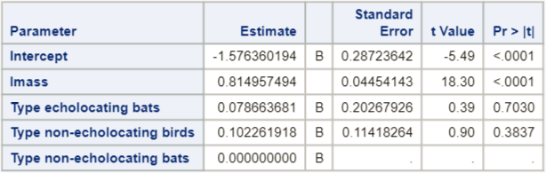
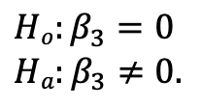
Echolocation!!!
QOI: Is there a difference in the in-flight energy of the TWO BAT types after body size is accounted for?
(Or, are the intercepts for the TWO BAT types different, after knowing that the slopes can be considered equal?)
$$μ\left\{lenergy \right|lmass, TYPE\}= β_{0}{+β}_{1}lmass{+β}_{2}bird{+β}_{3}ebat{+β}_{4}lmass∗bird{+β}_{5} lmass ∗ebat$$
Individual regression equations for each relevant value of TYPE:
$μ\left\{lenergy \right|lmass, TYPE=ebat\}=(β_{0}{+β}_{3})+β_{1}lmass$: intercept = $β_{0}{+β}_{3}$
$μ\left\{lenergy \right|lmass, TYPE=nebat\}= β_{0}+β_{1}lmass$ : intercept = $β_{0}$
Both intercepts are equal if $β_{0}{+β}_{3}=β_{0}, or β_{3}=0$.
$$Ho:β_{3}=0$$
$$Ha:β_{3}≠0.$$
Choosing one of the TYPES of interest to be the reference level makes this easy!
Data are consistent with the hypothesis of equal median in-flight energy expenditures between two bat types after accounting for the mass (size) (p-value = .7030).

Slide 15
Part 3: Takeaways

Slide 16
Please Provide a summary of at least 4, but as many any as you like, takeaways from this unit!

Slide 17
Part 4: Questions or Comments

